Slide 1
Improving computer vision models at scale
Dr. Mirko Kämpf | Senior Solutions Architect
Notes:
Introduce yourself
Focus of the presentation: highlight the opportunity in various industries of using image recognition but also the challenges associated with doing it at scale. We’ll then go into detail how Cloudera uniquely addresses the problem and how you can get started.

Slide 2
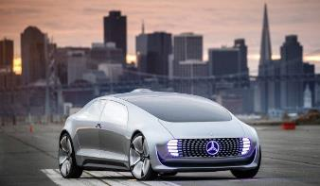
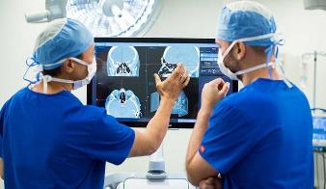
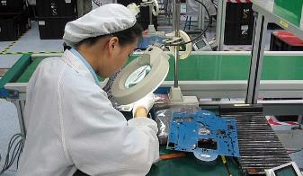
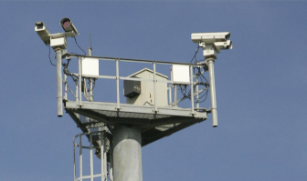
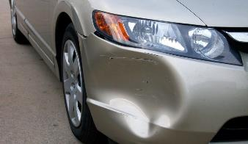
VISION IS EVERYTHING
Automotive OEM & Tier1 Suppliers
Healthcare & Medical Devices
Manufacturing & Pharmaceuticals
Security &
Public Sector
Insurance
Autonomous vehicle programs
Physician augmentation and robotic devices
Visual inspection for quality & yield
Customs & border protection, anti-crime efforts
Claims processing and fraud detection using images & video
Notes:
Computer vision in the next major opportunity for innovation or (service) enhancement for a host of industries.
What if you could automatically
→ identify dangerous situations in traffic in AV/ADAS
→ detect extremely hard to find tumors in healthcare
→ pinpoint broken or reduced quality parts in a chip manufacturing line
→ uncover terrorist or drug smugglers from satellite data
→ asses and approve insurance claims
Tremendous impact

Slide 3
Imagine the possibilities...
Computer Vision technology allows us to:
  detect tumors in medical images
  detect broken parts in a manufacturing line
  detect violence in public spaces
  detect dangerous situations in traffic
  detect a fire early
... all that @ scale and USING the cloud!

Slide 4
Be Open and Think Big!
Cameras are everywhere ...
  In traffic (cars, trains, planes)
  In public places (train stations, air ports, public buildings)
Many public datasets are available ...
  Udacity: autonomous driving datasets
  Medical images
Search like (with) Google:
  Dataset serach is a great new tool.
  Image search makes grabbing tagged images as easy as never before.
Cloudera builds enterprise solutions on open standards.

Slide 5
BIG DATA, Machine Learning, ARTIFICIAL INTELIGENCE
BUT… There are challanges
Notes:
It’ll be clear to many that ML is going to deliver that computer vision, that image recognition, but there are distinct challenges when trying to do this at scale.

Slide 6
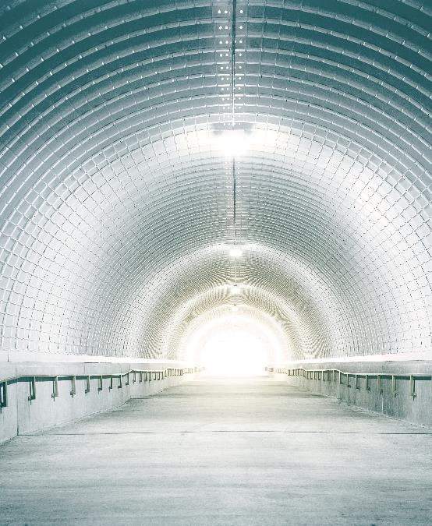
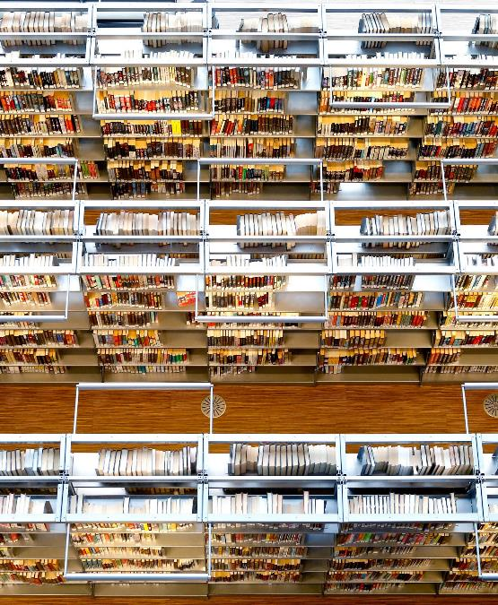
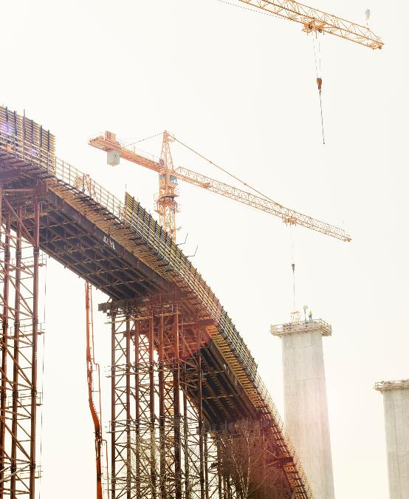

challenges
MANAGEMENT
VOLUME
ANNOTATION
Notes:
A note on images: should be from our corporate ones (https://cloudera.box.com/s/ytt8n9djn19b81qua4cfwnz5h8bsqawf).
At a high level (we’ll go into detail in the next few slides), there are three challenges to working with image data in order to craft image recognition models:
Volume – the required storage is massive and in the PB range even for the smallest of projects. Even the compute power needed to ingest it poses significant problems.
Annotation – mammoth effort, thousands of hours
Management – putting together the right image set for the use case is a tedious manual task, only carried out within the team or department. There is no visibility of what else is out there.
Lets look at a bit more detail on each of these challenges

Slide 7

Volume challenge
100’s PB
Notes:
Size
Even small image recognition models require 100s of PB in development and training images. Storing such a volume is a headache in its own right.
Added to that is the complexity of the formats. Images are often stored in very proprietary manners.
MDF4 is an automotive standard developed by Robert Bosch GmbH, initially used for ECU development, calibration and testing. It is now the de-facto standard in the measurement & calibration area.
Digital Imaging and Communications in Medicine (DICOM) is the standard for the communication and management of medical imaging information and related data. It is most commonly used for storing and transmitting medical images and is widely adopted by hospitals.
The challenge is that image recognition models work with much more mundane image formats like JPEG or PNG. Part of the prep work (before we get to any of the next challenges) is unpacking the proprietary format, extracting the JPEG/PNG and somehow storing that, along with the original and all metadata. There’s also a significant amount of compute power required to do just that.
From https://en.wikipedia.org/wiki/Comparison_of_graphics_file_formats
ARW
BAY
CAL
CPC
DCS
DCR
DICOM
ECW
ICER
ICS
SIP
MDF4

Slide 8
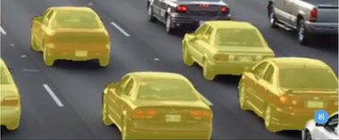
annotation challenge
“Let’s consider Cityscapes dataset (useful for self-driving cars). Fine pixel-level annotation of a single image from cityscapes required more than 1.5 hours on average.
They annotated 5000 images. With a simple math we can calculate, that they spent about 5000 * 1.5 = 7500 hours...”
Source: https://hackernoon.com/%EF%B8%8F-big-challenge-in-deep-learning-training-data-31a88b97b282
Are you willing to invest for thousands of hours?
Industry prefers automation!
Notes:
The next challenge is one of annotation. Image recognition models need to be told what to look for. They need the raw material to learn from. And that’s annotated images where objects or events are classified. What comes natural to us, is a right challenge when we need to explain it to a machine. Is the image one taken during the day or night? Is it sunny or cloudy? What direction is the cyclist travelling and are they in front of behind the stop sign?
In essence, you need to know
* THINGS (pedestrian, stop sign, hot spot, gun, …)
* RELATIONSHIPS (close by, in front of, above, underneath, ...)
* ACTIVITIES (danger, theft, evasion, escape)
in image data.
Doing that for one image on a pixel by pixel basis takes around 1.5h. How many images do you need to develop and train your models? Thousands? Millions?

Slide 9
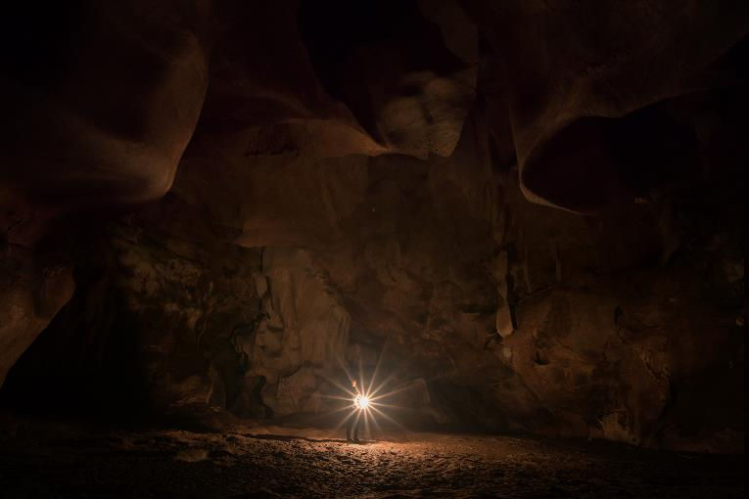
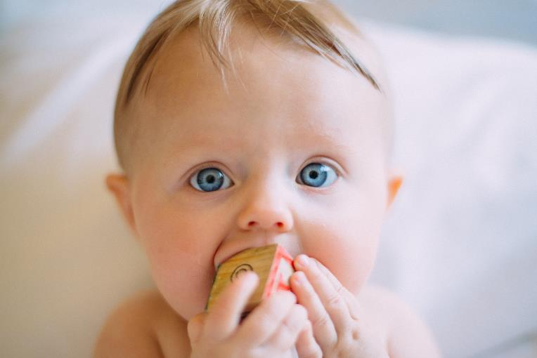
Management challenge
DISCOVERY
SHARING
Notes:
The last challenge is one of managing all this data.
Being able to find the right images to pull together in a set for development and training, across thousands or millions of files. And you needs lots of images because more data (properly annotated) begets better models. But it’s a bit like shining a candle in a massive cave. If you’re lucky, you find the edge, some structure to hold on to. It’s rare you find just what you need, a cluster of diamonds or a needle.
And if you can’t find what you need, what are the chances that your colleagues, in other teams, in other departments, find what THEY need? There is no sharing because we can’t find what we need in the first place. So every one builds their own training sets, doing the same work time and again.

Slide 10


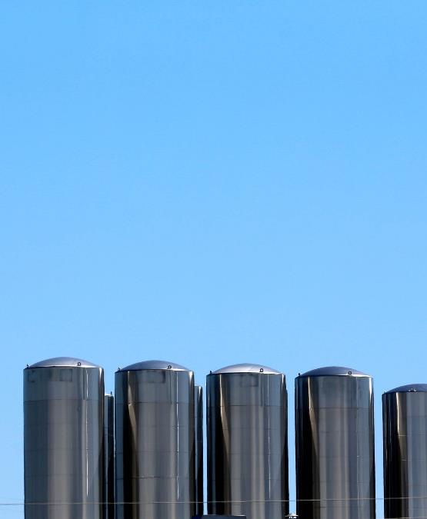
Resulting status quo
VAST UNKNOWN
SMALL TRAINING SETS
USED IN ISOLATION
Notes:
As a result, organisations have masses upon masses of unknown, unclassified, unannotated images (provided they solved the storage challenge) that may or may not hold just the nuggets they need.
They work with what they do know, what they DID manage to annotate and classify as the basis for their model development. In comparison to what they potentially have, small sets of data
Small sets of data that are used in isolation since they are not discoverable and shareable

Slide 12
Cloudera difference
Notes:
We can help; we’ve cracked that nut

Slide 13
Intersection of two worlds
Digital Asset Management
Data Science Platforms
Automated annotation of new data
Optimized model imporvements
Notes:
What’s we’re looking at is something that has DAM and Data Science platform like capabilities.
But adds automation of annotation to achieve scale and addresses the challenges of training set management.
It’s not a better of either; it’s a better application and implementation of services and libraries.

Slide 14
ML-POWERED, DOMAIN-AWARE IMAGE REPOSITORY FOR DATA SCIENCE
Core functions: Implemented as reusable building blocks:
Provide extensible, repeatable, and focused solutions
Asset Acquisition and Processing
Processing of digital assets with machine learning annotation and enrichment
Domain-Oriented Query and Access
Semantic query asset acquisition and discovery with domain specific ontologies
Training Set Management
Using the “domain aware DAM” to generate and retrieve relevant data sets for model development and automated testing
Model Development
Employing relevant training sets in a shared data science environment to construct domain-specific model and to power automated model testing services
This looks a bit like a part of a supply chain, doesn’t it?
Notes:
What we offer is an application of our platform through the delivery of a framework for an image access layer combined with services. What if you could:
[click]
Not only bring in the various image formats and store them in a scalable manner, but also use ML itself to annotate and classify using domain specific models?
[click]
Then can query all images to find the right things happening in the right context to the right objects
[click]
So you can pull together and manage potentially massive training sets that are focused on your use case
[click]
And you can develop and deploy image recognition/computer vision models based on them with rigor

Slide 15
What is Image logistics?
... the problem we solve ;-)
  Provide images into training procedures efficienty (fast!)
  Identify relevant images to train better DNN.
  Rearrange images quickly, to adopt users needs
  Manage multiple kinds of metadats: movies, images + context data
  Manage dataset lifecycle of compound datasets

Slide 16
How things work
Notes:
Let’s look at the detail of how each of these four steps work and come together

Slide 17
Data Engineering and Model Life cycle
Data Engineering and Model Lifecycle
Notes:
Let us examine how we have implemented the backend, leveraging Spark to distribute the labeling with neural nets.

Slide 18
FUNCTIONAL Requirements
Fast random access to images
Free text search for labels / tags / statistical properties
Execute existing Python and Scala deep learning pipelines at scale
Automatic labeling and indexing of detected facts
Visual model comparison
Search for complex scenarios: situational awareness
Notes:
But before we dive into the detail, let’s first look at what we actually need

Slide 19
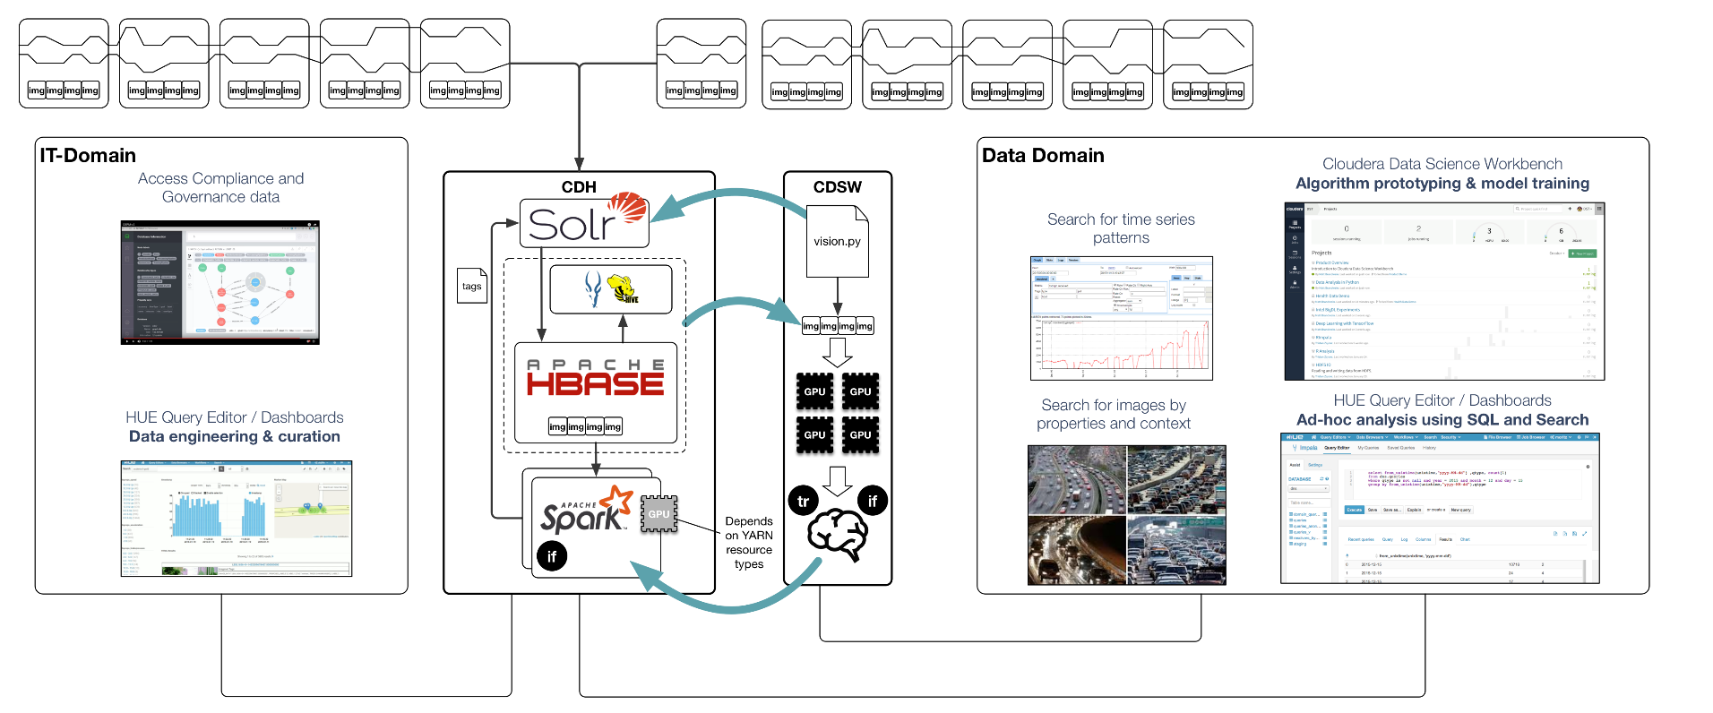
Solution overview (1)
Notes:
At a high level and from an architecture perspective, this is how our solution works:
Ingest images
Unpack and standardize their representation
Domain specific annotation and classification
Semantic search
Compilation of use case specific training sets based on the results
Rigorous model development and deployment

Slide 20
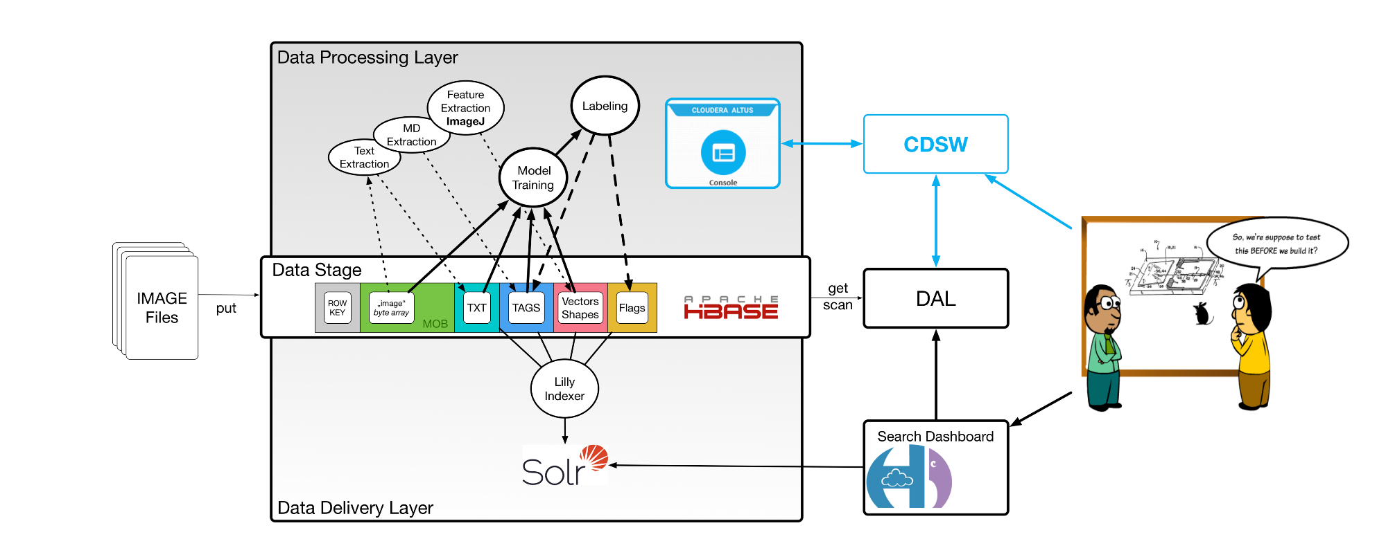
Solution overview (2)
Main users:
Data Scientist
and
Domain Experts
Notes:
Image data are in the focus of our activities. The data model is driven by Hbase design principles.
Images are unique and all related information – no matter what – can be “linked” to it. Technically, we use specific column families to address the specific needs for each data-flavor.
Our solution is ready for the cloud. It encapsulates all the technical complexity behind intuitive Web-Uis.

Slide 21
Concepts for efficient Image warehousing:

Slide 22
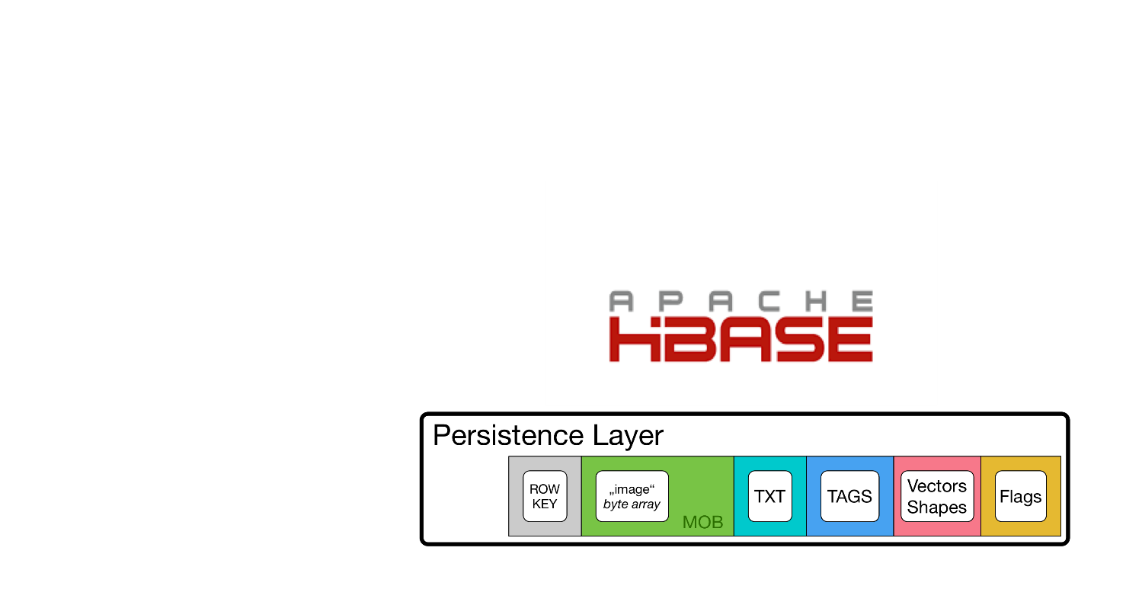
COMPOUND DATASETS - ASSET Acquisition
Image
+
Metadata
Notes:
Standardise image representation and extracted meta data
4.8.2018: (MK)
- UPDATED the sketch of our HBase Data Stage.

Slide 23
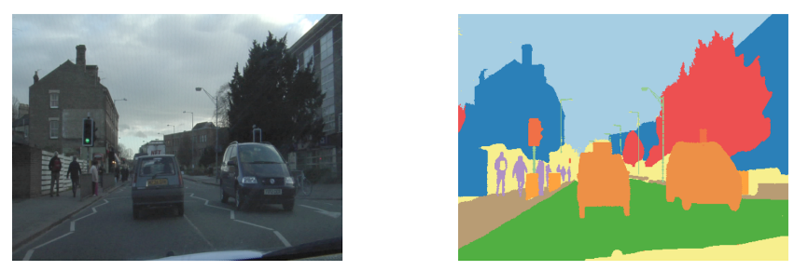

UNIFIED Asset Processing
ONE API – MANY FRAMEWORKS – MANY MODELS
Domain specific attribute extraction and enhancement
Additional domains added as needed
Autonomous driving
Disease identification
Notes:
Process image using domain specific ML model to annotate and extract or derive further meta data (e.g. depending on bounding box overlap, one object may be inferred as being in front or behind of another; this relationship becomes an additional piece of information)
Object detection
InceptionV3 [1]
Semantic Segmentation
SegNet [2]
Bounding Boxes
RetinaNet [3]
Object masking
Detectron [4]
[1] Christian Szegedy, Vincent Vanhoucke, Sergey Ioffe, Jonathon Shlens, Zbigniew Wojna: " Rethinking the Inception Architecture for Computer Vision” https://arxiv.org/abs/1512.00567
[2] Simon Jégou, Michal Drozdzal, David Vazquez, Adriana Romero, Yoshua Bengio: " The One Hundred Layers Tiramisu: Fully Convolutional DenseNets for Semantic Segmentation”, https://arxiv.org/abs/1611.09326
http://mi.eng.cam.ac.uk/projects/segnet/demo.php#demo
[3] Tsung-Yi Lin, Priya Goyal, Ross Girshick, Kaiming He and Piotr Dollár: "Focal Loss for Dense Object Detection”, https://arxiv.org/abs/1708.02002., https://github.com/fizyr/keras-retinanet
[4] https://github.com/facebookresearch/Detectron

Slide 24
Tenzing
Access to large image datastes simplified
We provide an API for accessing images and image sets via Apache Spark,
for tagging/labeling (in CDH) and model training (in CDSW).
Solr’s powerful search capabilities are used to identify the right images.
The complexity of allocating individual images or image sets within HBase is hidden within the data access layer (DAL), and the Tenzing-API.

Slide 25
A Full Data Pipeline FOR THE TRAFFIC DOMAIN:

Slide 26
SOME IMPLEMENTATION Details ...

Slide 27
PySpark implementation (Keras)
def predict(iterator):
model = InceptionV3(weights=None)
model.load_weights(FLAGS.weights_file)
return [(x[0], run_inference_on_image(model, x[1])) for x in iterator]
def main():
sc = SparkContext(conf=conf)
hbase_io = common.HbaseIO(FLAGS)
out_format = common.OutputFormatter(FLAGS, MODEL_NAME)
hbase_images = hbase_io.load_from_hbase(sc)
classified_images = hbase_images.mapPartitions(predict) \
.map(out_format.imagenet_format)
classified_images.foreachPartition(hbase_io.put_to_hbase)
Notes:
To match the preference of the data scientists the first language we have added support for is Python via the PySpark API. We have used the Keras framework with the Tensorflow backend to implement models. Spark is used to read the raw images from HBase, preprocess them, instantiate a model instance for each partition and finally write the labels to HBase. It is important to note that to add a new model only the lines highlighted with green color are required to be changed.

Slide 28
PySpark implementation (Keras)
The Python environment with tensorflow is distributed to the executors at runtime, it is not preinstalled on the nodes.
The individual models only need to implement the following functions:
  prepare
  predict
  output_format
Conceptually very close to scikit-learn or Spark ML Pipelines approach
Deep Learning Pipelines can be a way to streamline the implementation
https://databricks.com/blog/2017/06/06/databricks-vision-simplify-large-scale-deep-learning.html
Notes:
The Python environment with tensorflow is distributed to the executors at runtime, it is not preinstalled on the nodes. When working with data scientists we have found that we best provide an API to them that hides Spark and Hbase to get them started. This API exposes functions that operate on individual images and model instances, there is no need to consider the complexity of distributed computation. With this in mind we can write an interface that is conceptually very close to the popular scikit-learn API. This does not expose the best ways to optimize performance, but gives users a convenient way to start with the platform.

Slide 29
Spark implementation (dl4j / Scala)
def predict(pairs: Iterator[(String, (INDArray, Int, Int))]) = {
val model = ModelSerializer.restoreComputationGraph(modelLoc)
pairs.map{ case (name, image) =>
(name, run_inference_on_image(model, image)
}
}
def main(args: Array[String]) = {
val sc = SparkContext(conf=conf)
val hbase_io = common.HbaseIO(args)
val out_format = common.OutputFormatter(args)
val hbase_images = hbase_io.load_from_hbase(sc)
val classified_images = hbase_images.mapPartitions(predict) \
.map(out_format.imagenet_format)
val classified_images.foreachPartition(hbase_io.put_to_hbase)
}
Notes:
We also provide a pure Scala implementation of the interfaces where we have used deeplearning4j as the example neural network library to provide the computer vision models. The concept are the same, with the only the syntax slightly changing.

Slide 30
VISUAL Model and Data Inspection

Slide 31
Domain-oriented query and access
Bounding box inspection for model comparison
Notes:
Not all models deliver the same results even though calculated values may indicate just that. Visual inspection will clearly show, in this case, the superiority of one model over the next. Crucially though: this is highly dependent on the use case that’s tested.

Slide 32
Domain-oriented IMAGE SEARCH
Semantic Search For End Users
Semantic search:
  Things
  Relationships
  Activities
  Situations
End user tools:
  HUE-Dashboard
  CDSW-Notebook
bounding boxes overlap
car in front of... truck
A property of the object-pair becomes a fact.
Facts are added to the search index.
This enables semantic serach easily.
Notes:
That is why it is so important to be able to query the results using a natural language (like) language from the various tools from which the users want to do just that.
Query image repository for images that are relevant for the use case in question
e.g. show me images where a car appears in front of a truck on a motorway during a sunny day

Slide 33
DEMO 1
Image Search and Model Comparison
Notes:
http://ciw-dev-gw.vpc.cloudera.com:8889/hue/search/?collection=325&q=tag:person
http://ciw-dev-gw.vpc.cloudera.com:8889/hue/search/?collection=325
http://ciw-dev-gw.vpc.cloudera.com:8889/hue/search/?collection=326
http://ciw-dev-gw.vpc.cloudera.com:8889/hue/hbase/#HBase/test_town_center/query/07a73dd0-5be7-42ce-9d87-260e5ae6cbaa,images:*

Slide 34
Visual label inspection via HUE:
How to Inspect Label Quality & Relations Between Objects?
Index contains:
object relations
predicted labels
object statistics
Rendered BoundingBoxes
are key to visual inspection.
- easy comparison of multiple:
model classes (A, B) or
model versions (C1, C2).
Model A
Model B
Notes:
Changed the textbox

Slide 35
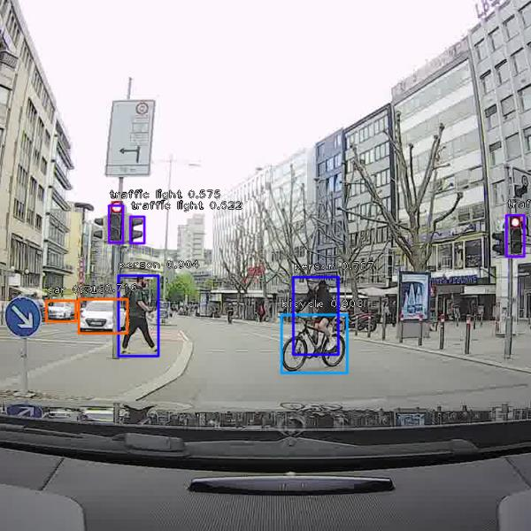
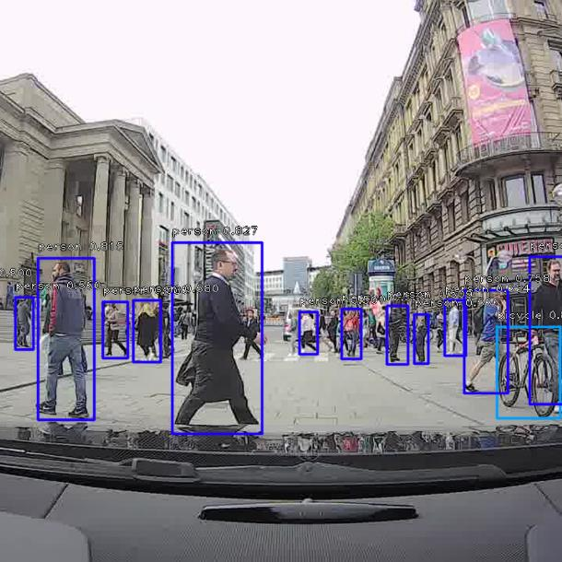
Training Set Management
Select the right data for the question
riders = ImageSet.select(”overlap:(bicycle, person)”)
Notes:
Search results can quickly and easily be pulled together and grouped to be used as input for model development.
When data scientists want to improve or further refine their models, they need to be able to bring together the right data set to do just that. Using a programmatical approach, the user can do just that and then update or refine the labels. Let’ say the user wants to make sure the model understands the difference between a cyclist and a person holding a bike. It’s important because both behave significantly differently on the road.
Getting these edge cases right can mean life and death when it comes to autonomous driving. If you recall the fatal Uber accident, one of the characteristics of the victim was that she was walking across the road holding her bicycle instead of riding it.
This is a relatively rare event and consequently the vision models are less equipped to handle them, unless we engineer them with the corner cases in mind.

Slide 36
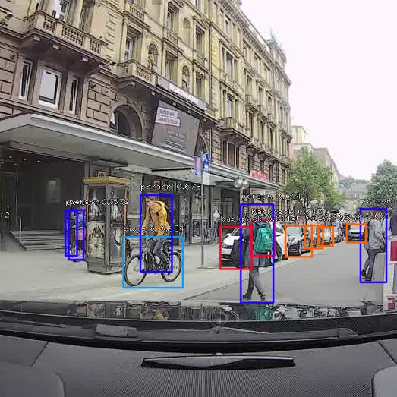
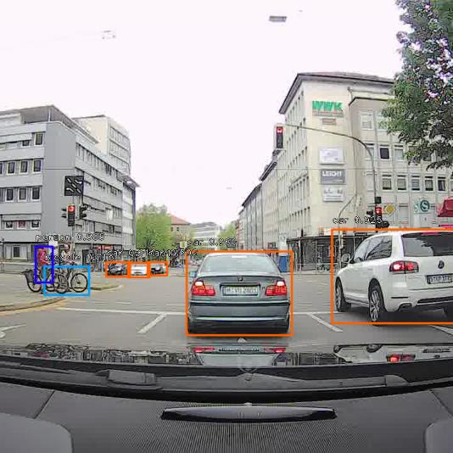
Model Development
Default models are usually not enough
rider_model = model.fit(
riders,
rider_labels,
epochs=30,
batch_size=20,
validation_data=(
validation_features, validation_labels)
)
cyclist
person holding bike
Notes:
Subsequent model development will allow the distinction between cyclists and a person holding a bike. This refinement is then added to the labels (or updated) and the complete set of source data (ALL images) can be updated

Slide 37
Next steps TOWARDS CONTEXTUAL AWARENESS

Slide 38
How to identify Semantic relations?
From labels to semantic graphs ...
Build an ontology for traffic scenes (or any other domain you work on).
Map statistical object properties to RDF graph using heuristics
Combine scene-graphs in a triple store
Search with SPARQL

Slide 39
How to WORK WITH semantic relations?
Creation of the local graph ...
Build Ontology for Traffic Scenes
Map statistical object properties to
RDF graph using heuristics
Combine scene-graphs (triple store)
Search with SPARQL
Object detection
  Deep neural networks
Bounding Box analysis
  Render BBs with labels
  Geometry based heuristics
    Overlap ratios
    Orientation analysis
SOLR Search by
  Labels
  Relations
SPARQL for RDF data
  Scene recognition

Slide 40
Why search on a knowledge base?
Provide a better search experience
Local knowledge graphs enable search for:
  THINGS (pedestrian, stop sign, hot spot, gun, …)
  RELATIONSHIPS (close by, in front of, above, underneath, ...)
  ACTIVITIES (danger, theft, evasion, escape)
  SITUATIONS (combinations of THINGS, RELATIONS, and ACTIVITIES)
... very fast, even in huge image collections.
Knowledge graphs remove the need to know SOLR schema details.
Notes:
Fixed a typo

Slide 41
Implementation of Complementary Search Channels
Triplification of information from images using local graphs

Slide 42
Moving forward

Slide 43
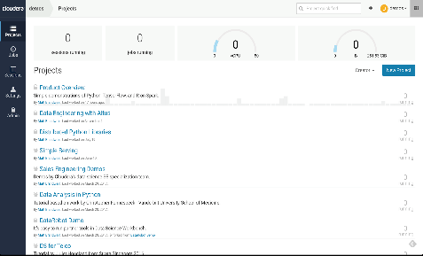
CLOUDERA DATA SCIENCE WORKBENCH
Accelerate machine learning from research to production
Data Science is an essential part
of the bigger picture
Notes:
Experiment faster
• Open innovation - Use R, Python, or Scala with your favorite libraries
• Data science at scale - Get powerful on-demand compute and direct access to unlimited data
• Work together - Share reproducible research with the whole team
Deploy with confidence
• No re-coding - Deploy models directly from development
• Flexible deployment - Run as report, batch, or REST API
• Build trust - Track model history and quickly rollback to old versions
Reduce risk and cost
• Unified platform - Break down silos by bringing data management and data science together
• Secure by default - Leverage common security and governance across workloads
• Run anywhere - On-premises or in the cloud

Slide 44
CLOUDERA DATA SCIENCE WORKBENCH
Accelerate machine learning from research to production
For data scientists:
Experiment faster
Use R, Python, or Scala with on-demand compute and secure CDH data access.
Work together
Share reproducible research with your whole team.
Deploy with confidence
Get to production repeatably and without recoding.
For IT professionals:
Bring data science to the data
Give your data science team more freedom while reducing the risk and cost of silos.
Secure by default
Leverage common security and governance across workloads.
Run anywhere
On-premises or in the cloud, on CPU or GPU.
Notes:
Experiment faster
• Open innovation - Use R, Python, or Scala with your favorite libraries
• Data science at scale - Get powerful on-demand compute and direct access to unlimited data
• Work together - Share reproducible research with the whole team
Deploy with confidence
• No re-coding - Deploy models directly from development
• Flexible deployment - Run as report, batch, or REST API
• Build trust - Track model history and quickly rollback to old versions
Reduce risk and cost
• Unified platform - Break down silos by bringing data management and data science together
• Secure by default - Leverage common security and governance across workloads
• Run anywhere - On-premises or in the cloud

Slide 45
OUTLOOK
EXTEND TENZING ... for better image processing
Notes:
http://cdsw-demo.sjc.cloudera.com/mirko.kaempf/ciw-phase-2-demo/engines/l3chpsfc37gkes9w

Slide 46
Image ClUstering usig K-Means
Extraction of image features
Conversion of specific data formats into:
org.apache.spark.mllib.linalg.{Vector, Vectors}
Features are persisted in this reusable format as a Parquet file
From here we go ... apply SparkML code to a part of the compound dataset.
Finally we feed the new labels back into the compound dataset
➔ e.g., for comparison of different clustering models with known clusters

Slide 47
DEMO 2
Image & Feature Processing
Notes:
http://cdsw-demo.sjc.cloudera.com/mirko.kaempf/ciw-phase-2-demo/engines/l3chpsfc37gkes9w

Slide 48
/GITHUB/TSA_finance/bin
./runSpark2.sh
import org.apache.spark.rdd.RDD
import org.apache.spark.mllib.linalg.{Vector, Vectors}
import org.apache.spark.mllib.regression.LabeledPoint
import org.apache.spark.mllib.clustering.{KMeans, KMeansModel}
import lire.Base64ImageConverter
import lire.LireToolWrapperGF
val sqlContext = new org.apache.spark.sql.SQLContext(sc)
import sqlContext.implicits._
// FEATURE EXTRACTION USING OPEN SOURECE LIBRARIES ...
// THIS IS ONE SLICE OF THE “COMPOUND DATASET”: Images can be vectorized in multiple ways, e.g., using color histograms
val dataPath = "/GITHUB/finance/data/out/image-analysis/A_2018-09-10-21-11-49/image_MD_ALL.parquet”
val df = sqlContext.read.parquet(dataPath)
val feature = df.select( "FCTH" )
val input = feature.rdd.map( x => x.getAs[org.apache.spark.mllib.linalg.Vector]("FCTH") );
val kmeans = new KMeans().setK(8).setSeed(1L)
val model = kmeans.run( input )
val WSSSE = model.computeCost(vectors)
println(s"Within Set Sum of Squared Errors = $WSSSE")
// Shows the result: TODO: WRAP THIS MODEL INTO A “TENZING LABELER WHICH ALSO PERSISTD THE RESULTS IN MD-Collection”
println("Cluster Centers: ")
model.clusterCenters.foreach(println)
val dataToCluster = ....
val labeledDdata = model.predict( dataToCluster )

Slide 49
OUTLOOK: Spark implementation oF KMEANS CLUSTERING (Scala)
def predict(pairs: Iterator[(String, (INDArray, Int, Int))]) = {
val model = ClusteringModelSerializer.restoreKMeansModel(modelLoc)
pairs.map{ case (name, imageFeatures) =>
(name, run_kmeans_clustering_on_image_features(model, imageFeatures)
}
}
def main(args: Array[String]) = {
val sc = SparkContext(conf=conf)
val hbase_io = common.HbaseIO(args)
val out_format = common.KMeansOutputFormatter(args)
val hbase_image_features = hbase_io.load_features_from_hbase(sc)
val clustered_images = hbase_images.mapPartitions(predict) \
.map(out_format.imagenet_format)
val clustered_images.foreachPartition(hbase_io.put_to_hbase)
}
Notes:
We also provide a pure Scala implementation of the interfaces where we have used deeplearning4j as the example neural network library to provide the computer vision models. The concept are the same, with the only the syntax slightly changing.

Slide 50
Summary
What we can do with image search today:
Search for combinations and amounts of objects at scale: „at least 5 cars and 2 trucks”
Search for basic relationship among those things: „In front of”, ”In a line with”
Enrich the search experience with other domains: geospatial, sensor data, etc.
This helps to:
Gain better understanding of the quality of our CV models/apps
Discover corner cases, improve model-lifecycle and
Build new (data) products faster
In the near future:
Focus on semantic search, advanced visualization
Improved model lifecycles and AutoML.

Slide 51
Many thanks to collaborators & supporters:
Anton Vukovic, Jan Kunigk, Marton Balassi
Alexander Bartfeld, Willem Stoop

Slide 53
Appendix: Getting data
  There are many great datasets out there for research purposes:
  Cityscapes, https://www.cityscapes-dataset.com/
  COCO, http://cocodataset.org/#home
  YouTube-8M, https://research.google.com/youtube8m/

